Slide 1
2021: Kratki pogled na mehanizme otpornosti
Nikola Mašić
Agency04
Notes:
If you need change photo in 04 - send e-mail to grgo.maric@ag04.com

Slide 2
Today's agenda
About me
Motivation
Software resilience
Overview of resilience patterns
Discussion

Slide 3
About me
Nikola Mašić.
MEngIT and Division Leader in Enterprise engineering.
Tech stack.
Java, SW Architecture, DevOps, Databases, Leadership.
Notes:
How to add a photo? Just click on the photo (grey area) and then “zamjena slike” - you can here add your photo.

Slide 4
Motivation
3 out of 10 Junior to Mid developers are not familiar with resilience!
My motivation.
Do we really care about software resilience?
When is the right time to take care about resilience?
How can my software become more resilient?
How can I measure resilience?
I want to learn more about resilience...
Notes:
How to add a photo? Just click on the photo (grey area) and then “zamjena slike” - you can here add your photo.

Slide 5
Software resilience
What is Software resilience
Must have quality for any software
Ability of software to heal from unexpected events
Resilient software will not try to avoid failure, but expect it and respond gracefully
Notes:
How to add a photo? Just click on the photo (grey area) and then “zamjena slike” - you can here add your photo.

Slide 6
“Basically, a system is resilient if it continues to carry out its mission in the face of adversity (i.e., if it provides required capabilities despite excessive stresses that can cause disruptions). Being resilient is important because no matter how well a system is engineered, reality will sooner or later conspire to disrupt the system. “
Software Engineering Institute blog of Carnegie Mellon University

Slide 7
Software resilience
Software resilience II - Why
Due to inevitable disruptions, availability and reliability are not sufficient
System must resist adversity and provide continuity of service even under degraded mode of operation.
System must recover rapidly from any harm.
Resilient system “can take a licking and keep on ticking”.
Notes:
How to add a photo? Just click on the photo (grey area) and then “zamjena slike” - you can here add your photo.

Slide 8
Software resilience
Software resilience III - Measurement
Not simple boolean function.
There is no 100% resilient system.
Resilience is not measurable on ordinal scale.
System A is more resilient than system B does not make sense.
Notes:
How to add a photo? Just click on the photo (grey area) and then “zamjena slike” - you can here add your photo.

Slide 9
Software resilience
Software resilience IV - Responsibilities
Detect adverse events and conditions.
Respond on disturbance.
Rapidly recover afterward.
Prevention is out of scope of the resilience.
Notes:
How to add a photo? Just click on the photo (grey area) and then “zamjena slike” - you can here add your photo.

Slide 10
Resilience patterns
Retry
Fallback
Circuit breaker
Bulkhead
Rate and time limiter
Cache

Slide 11
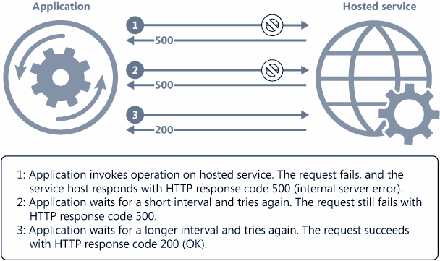
Retry. Handle transient failures when it tries to connect to a service or a network resource, by transparently retrying a failed operation
Software resilience

Slide 12
Software resilience
Fallback
Provides an alternative solution during a service request failure.
Fallback logic does little or no processing, and return value:
Custom fallback
Fail silent
Fail fast
Notes:
How to add a photo? Just click on the photo (grey area) and then “zamjena slike” - you can here add your photo.

Slide 13
Software resilience
Circuit breaker
Prevent an application for repeatedly trying to execute an operation that’s likely to fail.
Acts as a proxy - state machine that mimic the functionality of an electrical circuit breaker:
Closed
Open
Half - Open
Notes:
How to add a photo? Just click on the photo (grey area) and then “zamjena slike” - you can here add your photo.

Slide 14
Software resilience
Bulkhead
Isolate services and consumers via partitions.
Useful for preventing catastrophic failures.
Pattern great for resiliency — performance hurdle for your application.
Notes:
How to add a photo? Just click on the photo (grey area) and then “zamjena slike” - you can here add your photo.

Slide 15
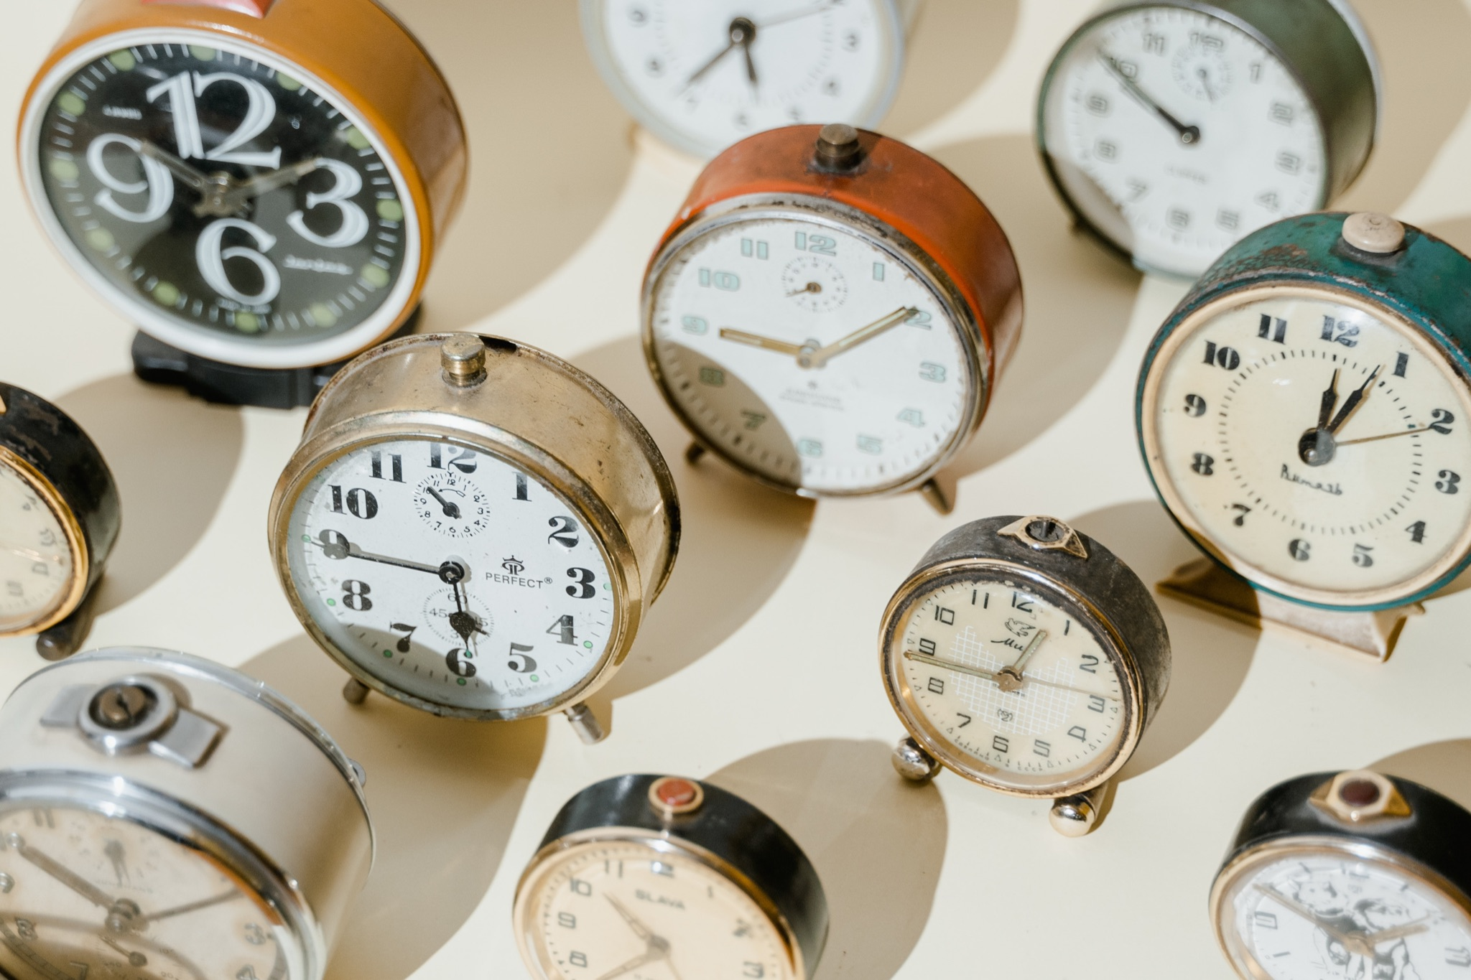
Software resilience
Rate limiter
Imposing limits on the rate at which other applications or service can access them.
Large-scale repetitive automated tasks (batch processing).
Time limiter
Limit the amount of time spent calling a remote service.
Notes:
How to add a photo? Just click on the photo (grey area) and then “zamjena slike” - you can here add your photo.

Slide 16
Software resilience
Cache
Improved application scalability.
Reduce load on downstream services.
Improved degradation.
Lower overall solution cost.
Notes:
How to add a photo? Just click on the photo (grey area) and then “zamjena slike” - you can here add your photo.

Slide 17
Software resilience
resilience4j
fault tolerance library designed for functional programming
https://github.com/resilience4j/resilience4j
Apache License, Version 2.0
polly
.NET resilience and transient-fault-handling library
https://github.com/App-vNext/Polly
New BSD License.
Notes:
How to add a photo? Just click on the photo (grey area) and then “zamjena slike” - you can here add your photo.

Slide 18
Talk time! Let’s have a chat.

Slide 19
Thank you!
Agency04.com

Slide 20
Literature
https://geshan.com.np/blog/2020/12/software-resilience/
https://www.it-cisq.org/pdf/How-Do-You-Measure-Software-Resilience-CISQ.pdf
https://insights.sei.cmu.edu/blog/system-resilience-what-exactly-is-it/
https://buildiumlife.medium.com/3-key-patterns-of-software-resilience-ae01f191a29e
https://docs.microsoft.com/en-us/azure/architecture/framework/resiliency/reliability-patterns
https://searchapparchitecture.techtarget.com/tip/5-proven-patterns-for-resilient-software-architecture-design
https://github.com/resilience4j/resilience4j
https://www.baeldung.com/resilience4j
https://medium.com/the-cloud-architect/the-resilient-architecture-collection-80cfce7edef3
…

