Slide 1
Performance Enhancements using Virtual Threads and Modern Memory Management
Dora Beronić Lara Modrić NINA NOVOSEL Branko Mihaljević, PhD
Notes:
Student research

Slide 2
Agenda
Comparison of Different Programming Languages
Concurrency in Java and Kotlin
Need for Structured Concurrency
Memory Management
Performance Comparison of Contemporary Garbage Collectors
Conclusion

Slide 3
Which programming language is the best?
Notes:
I would like to start with one on the most freaquently asked, million dolar questions in the IT industry, which is? What programming language is the best?

Slide 4
Notes:
We can not say that one programming language is the best, and that one language is better then the other in every way. But some languages preformen better in certain cases.
The tricky gueston we could get after the “smart answer” “it depends” is “Depends on What”, how to compare different programming languages.

Slide 5
What to Compare?
CPU
Memory
Development time

Slide 6
Comparison of Different Languages
Python
PHP
Node.js
C#
Go
Kotlin
Java

Slide 7
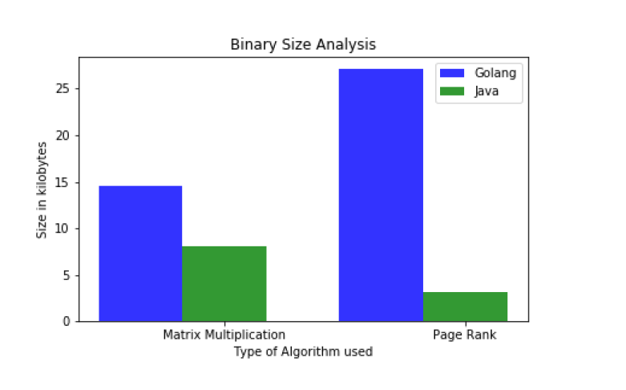
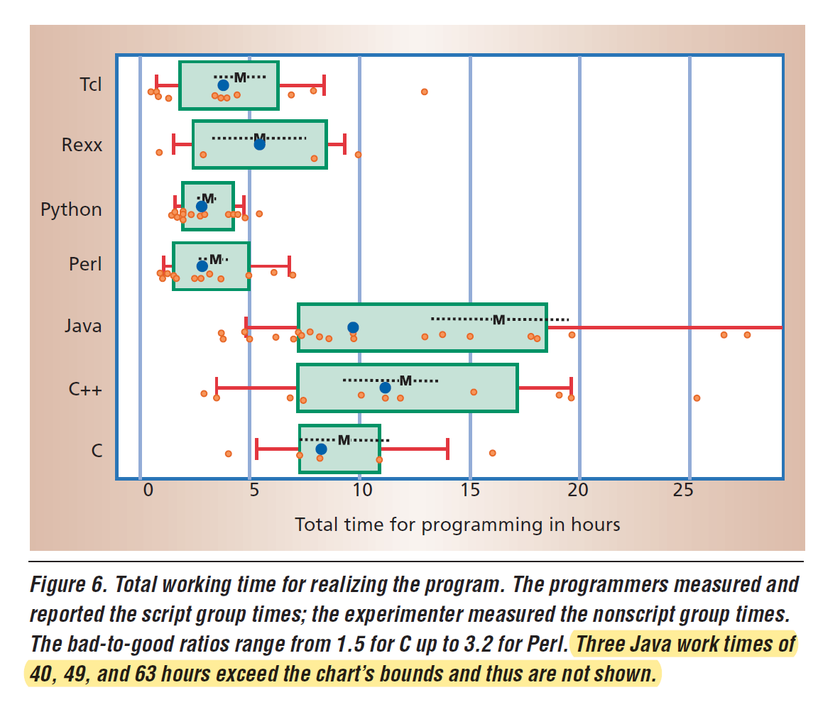
Studies Have Shown
Notes:
Python does not perform as well in the web environment as it does in machine learing
PHP preforms well on smaller and medium size application, but messures a significant decreese in performance for larger applications.
Node.js preforms really well on large scale application, but does not support syncrounous programming, meaning that it might cause problems with code readability.
C# has really good readability but does not have a high level Thread API, and is therfore signifficanly outperformed by Java since the developers are aple to optimize the threading processes.
Java Threads preform well when we talk about concurrency, but the JVM is heavy for small scale applications and Java Threads thend to outlive their tasks, which is a major problem. While Go and Kotlin solved the Thread mapping with lightweight implementation of threads however this negatively influenced their code readability.
Leavening us a bit confused on which language to use? Soo..

Slide 8
Why not Java?

Slide 9
Concurrency in the JVM

Slide 10
Concurrency
Handling multiple tasks at the same time
Switching contexts between tasks

Slide 11
Threads in Java and Kotlin
JVM threads → wrappers around OS threads
Scheduling done by OS
Kotlin’s threads library connected to Java’s threads
Kotlin Thread
JVM Thread
OS Thread
Notes:
- Say that Kotlin compley relies on the JVM

Slide 12
Need for structured concurrency
JVM threads → dependency on OS threads
Affecting application efficiency
Lightweight structured concurrency models → increasing efficiency
Virtual threads in Java (Project Loom)
Coroutines in Kotlin

Slide 13
Project Loom
Early access build
New JDK Model
Tail calls
Virtual threads
Release – Soon ???

Slide 14
Virtual Threads
Experimental → Project Loom
Simple to implement in code
Scheduling done by the JVM

Slide 15
Concurrency in Java
Thread
Virtual THread
Scheduled: OS
API: Stable (java.lang.Thread)
JVM version: any
Stack size: about 1MB
Connection to OS Thread: one-to-one
Scheduled: JVM
API: Experimental
JVM version: Project Loom early access build
Stack size: couple of KBs
Connection to OS Thread: many-to-many
Notes:
Za Api mozes reci da se prilagodava java.lang.Thread API

Slide 16
"Whereas the OS can support up to a few thousand active threads, the Java runtime can support millions of virtual threads."
- Ron Pressler

Slide 17
Mapping to the OS Threads
JVM threads
Virtual threads
OS threads
Notes:
Current Threads are mapped to the OS Thread since they are created until they are swapped by the garbage collector, they can not release them.

Slide 18
Scheduling
wait
wait
Virtual thread
OS thread 1
OS thread 2
OS thread 3

Slide 19
Concurrency in Kotlin

Slide 20
Coroutines
Included in Kotlin → kotlinx.coroutines library
Not dependent on OS threads
Easy to implement + increased performance

Slide 21
Syntax Comparison

Slide 22
Syntax explanation
/
A simple implementation of a multi-threaded server
Thread-per request model
Storing the data
Notes:
Storing the data in our example referes to saving data into a file which represents and database that requires blocking operations

Slide 23
Java Threads
Notes:
We created a runnable task for each server.

Slide 24
Java – Virtual Threads

Slide 25
Kotlin Threads

Slide 26
Kotlin Coroutines
Notes:
Greater difference between Coroutines and Threads then in Java

Slide 27
Performance Comparison

Slide 28
Usage of OS Threads
Rate | 2000 | 8000
Java - threads | 100017,33 | 388749,67
Java - virtual threads | 35,67 | 268,33
Kotlin - threads | 100016,00 | 382669,67
Kotlin - coroutines | 23,67 | 23,67
Number of used OS Threads after 5 seconds of 2000 and 8000 requests pers second attack rate

Slide 29
Heap Used

Slide 30
Latency

Slide 31
Virtual Threads vs Coroutines
Virtual threads → better usage of heap memory
Coroutines → better stability when it comes to usage of OS threads
Both → significantly better latency and performance results than standard threads implementation

Slide 32
What else?
polyglot machines
memory management and garbage collection
possible future improvement of virtual threads

Slide 33
Modern Memory Management
Notes:
We can not say that one programming language is the best, and that one language is better then the other in every way. But some languages preformen better in certain cases.
The tricky gueston we could get after the “smart answer” “it depends” is “Depends on What”, how to compare different programming languages.

Slide 34
Memory Management
process of controlling and coordinating computer memory
govern memory in an efficient manner
improve overall system performance
Notes:
Memory management is all about performance.
Therefore, we can say that memory management is as a process of controlling and coordinating computer memory by allocating blocks of memory to multiple operating processes in order to govern memory in an efficient manner and improve overall system performance.

Slide 35
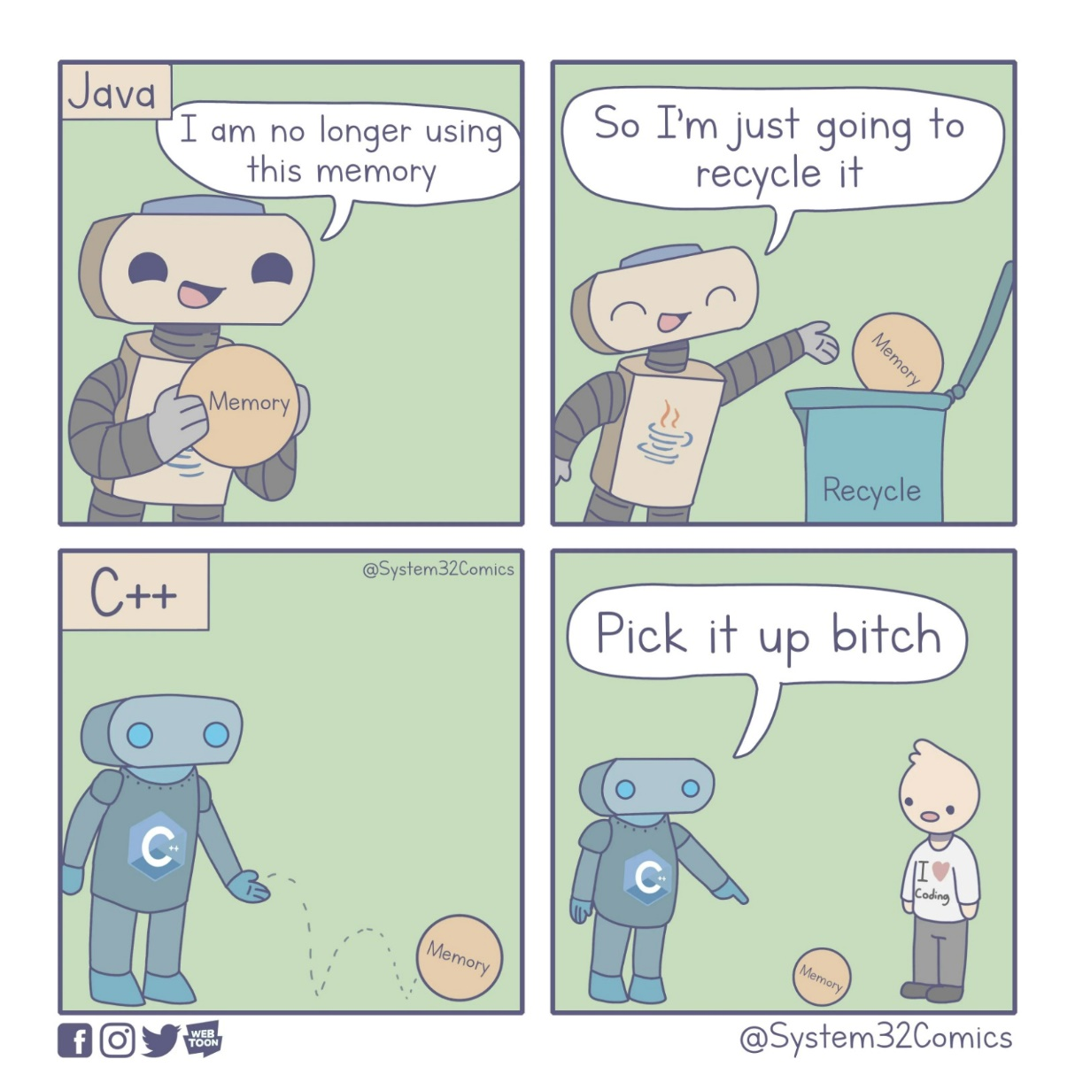
Notes:
One of the perks of automatic memory management

Slide 36
Manual Memory Management
wasteful heap usage
out-of-memory issues
data corruption
inefficient memory management
Notes:
Continuing that, there are 2 types of memory management. And it is in fact the same as it is with cars. There is manual and there is automatic.
Manual memory management is present in some lower-level programming languages, such as C or C++ and it can cause many problems at a runtime. For example, objects that are no longer used in heap memory can cause wasteful heap usage and potential out-of-memory issues. Moreover, accidental releasing memory of objects still in use could cause data corruption. Both cases could lead to significant problems related to inefficient memory management and, consequently, potential critical production problems.

Slide 37
Automatic Memory Management
modern OOP languages
garbage collection algorithms
free memory from objects with no active references
released memory available for further usage ASAP
Notes:
As opposed to that there is also automatic memory management, which is present in the majority of modern (or high-level) object-oriented programming languages, such as Java. And the capability of performing automatic memory management is one of its core features. In Java, automatic memory management is performed within the Java Runtime Environment and the Java Virtual Machine.
This is achieved through efficient garbage collection algorithms. And the primary goal of those algorithms is to free the memory from objects with no active references that would keep a pointer to them in some section of the application. In this case, garbage collection operations are performed automatically at regular intervals, last for a certain amount of time, and result in evident benefits of appropriately reclaimed memory. The main premise is that Java applications occupy only the necessary amount of space, and the released memory should be available for further usage as soon as possible.

Slide 38
"If Java had true garbage collection, most programs would delete themselves upon execution."
- ROBERT SEWELL
Notes:
And here is a one really nice quote about automatic garbage collection. It really gives you something to think about.

Slide 39
Automatic Memory Management
attempts to reclaim memory, which was allocated by the program but is no longer referenced
total processing time
influnece on performance
difficulties associated with manual memory management are eliminated
preventing memory leaks and dangling pointers
Notes:
But continuing on Automatic Memory Management there are many difficulties associated with it that are eliminated through the usage of automatic garbage collectors. Some of the other benefits of usage of garbage collectors include preventing and removing simple memory leaks (such as forgetting to release unused objects) and dangling pointers (which occur when the memory is cleaned, but the references remain).
However, nothing is perfect and everything comes with a cost. And since this process attempts to reclaim memory, which was allocated by the program but is no longer referenced, it may take a significant proportion of total processing time and, as a result, can have a considerable influence on performance.
Therefore, since garbage collection algorithms can, in some cases, negatively influence the application's performance, it is crucial for software developers that they are familiar with the garbage collection's core processes.

Slide 40
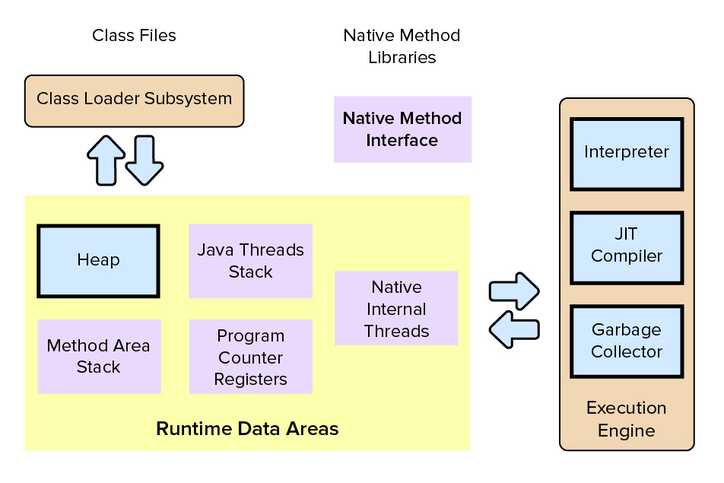
JVM Core Components
Notes:
And from the perspective of potential application performance tuning, there are three core components of the Java Virtual Machine that developers must take into account when implementing an application with efficient memory management – the heap, compiler, and garbage collector.

Slide 41
Garbage Collector
in charge of the heap
allocation and release of memory for application
improves memory efficiency by automatically removing unreferenced objects from heap
prevents errors
Notes:
But what is the garbage collector after all? So, as mentioned before, the garbage collector is in charge of the heap where it serves as an automatic memory manager. It manages the allocation and release of memory for an application. In this way garbage collectors improves Java memory efficiency by automatically removing unreferenced objects from the heap memory and enabling space for new objects to be created. In this way, some types of errors can be avoided by relieving the software developer of the responsibility of performing manual memory management which includes matching memory allocation with deallocation and keeping track of object lifetimes.

Slide 42
GC Approaches – Mark and Sweep 1. Stops all running program threads 2. Traverses through reference tree 3. Marks any found object as alive 4. Every remaining object regarded as garbage
Notes:
There are several garbage collection approaches used by the modern GCs.
However, the early garbage collection algorithms mostly used the Mark and Sweep approach to recover and reuse heap memory that is no longer in use by the application. In its most basic form, this approach stops all running program threads with the so-called stop-the-world event. After that, it traverses through the reference tree of utilized objects and marks any object found as alive. Every remaining object is regarded as garbage and is then ready to be collected and swept.

Slide 43
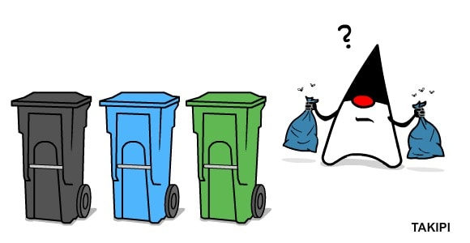
Mark and Sweep Shortcomings
not suitable for multithreaded applications
inefficient and time-consuming
heap size and number of living objects increases
Notes:
However, this stop-the-world approach was not suitable for multithreaded applications, as it could become inefficient and time-consuming since it is stopping all threads. Additionally, as heap size and the number of living objects increases, the amount of time an application is interrupted for garbage collection grows.

Slide 44
Modern GC Approaches keeping all processes active as long as possible Concurrent collectors – collector thread runs on one process while the program threads keep running concurrently on the other processes Parallel collectors – stopping all program threads completely and then running the collector in parallel in several collector threads
Notes:
Due to those reasons, two other approaches pioneered with the task of keeping all processes active as long as possible:
Concurrent collectors – collector thread runs on one process while the program threads keep running concurrently on the other processes
Parallel collectors – stopping all program threads completely and then running the collector in parallel in several collector threads
Although GCs may employ different approaches to optimize their target performance metrics, in the general case, they tend to make a trade-off between throughput (number of operations done by an application), pause time (time that an application is forced to stop to let the GC execute), and memory usage (the amount of memory used in a process).

Slide 45
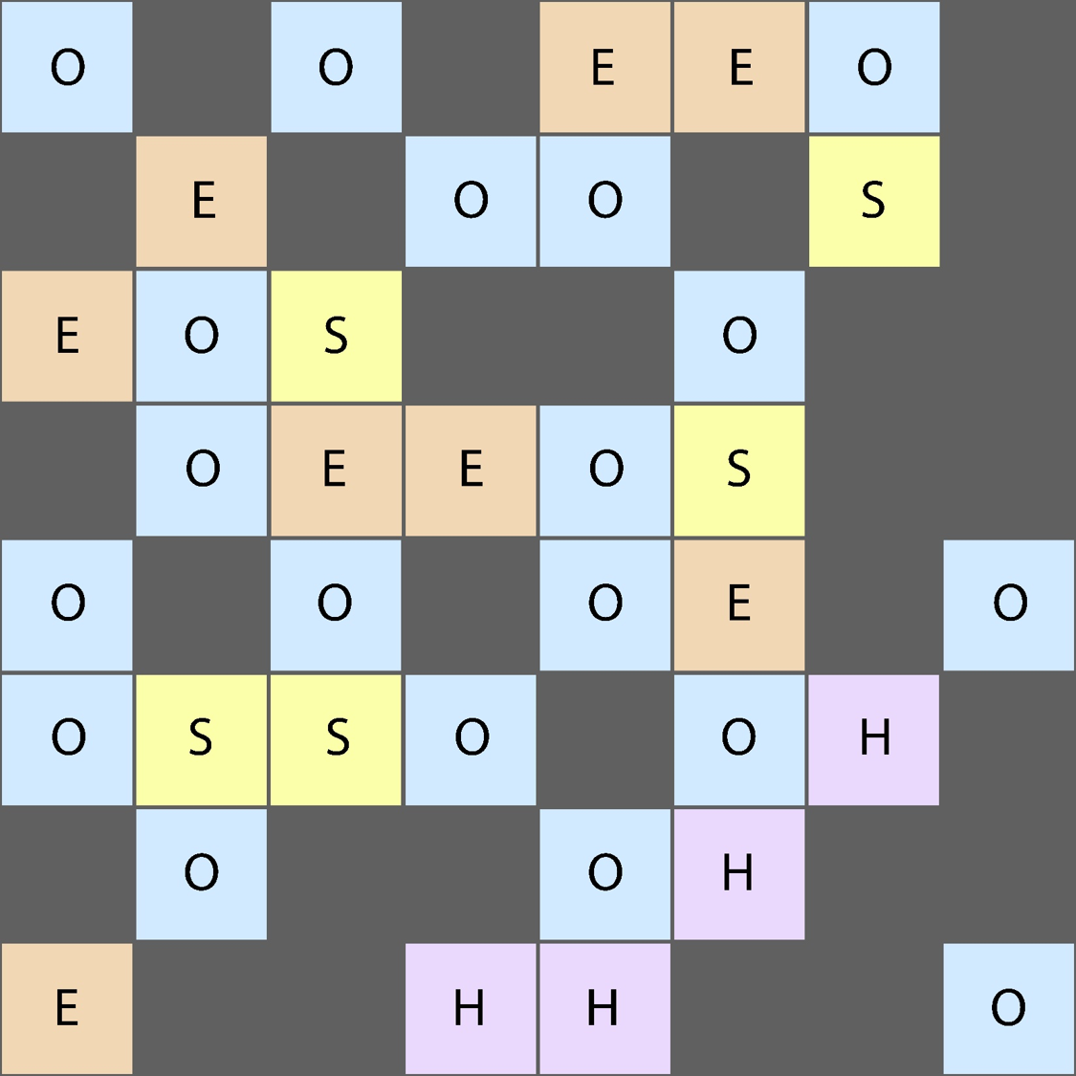
G1 Garbage Collector Eden Space (E), Survivor Space (S), Old Generation (O) and Huge Area (H), Empty (unmarked)
Notes:
Current Threads are mapped to the OS Thread since they are created until they are swapped by the garbage collector, they can not release them.

Slide 46
Shenandoah Garbage Collector Newly Allocated (blue), Live Data (violet), Live Data in Collection Set (yellow), Live Data in Collection Set Updating References To (orange), Free (gray)
Notes:
Current Threads are mapped to the OS Thread since they are created until they are swapped by the garbage collector, they can not release them.

Slide 47
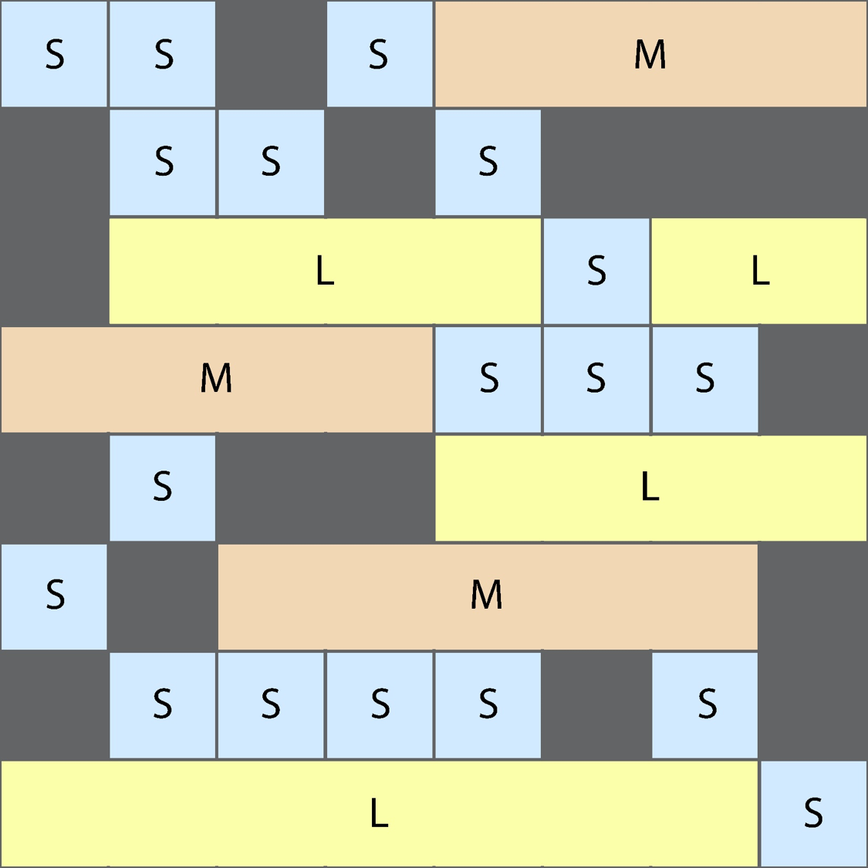
Z Garbage Collector Small (S), Medium (M), Large (L), Empty (unmarked)
Notes:
Current Threads are mapped to the OS Thread since they are created until they are swapped by the garbage collector, they can not release them.

Slide 48
Let’s run some benchmarks

Slide 49
DaCapo
avrora – simulates a number of programs run on a grid of AVR microcontrollers
h2 – executes a JDBC bench-like in-memory benchmark, executing a number of transactions against a model of a banking application, replacing the hsqldb benchmark
pmd – analyzes a set of Java classes for a range of source code problems
xalan – transforms XML documents into HTML
Notes:
H2 – blocking operations

Slide 50
Renaissance
movie-lens – movie recommender using the ALS algorithm
fj-kmeans – an application that is running the k-means algorithm using the fork/join framework
db-shootout – execution of shoutout tests while using several in-memory databases
par-mnemonics – an application that solves the phone mnemonics problem using parallel JDK streams

Slide 51
DaCapo

Slide 52
Renaissance
Notes:
Fj-kmeans – somewhat concurrent
Par-mnemonics – parallel streams

Slide 53
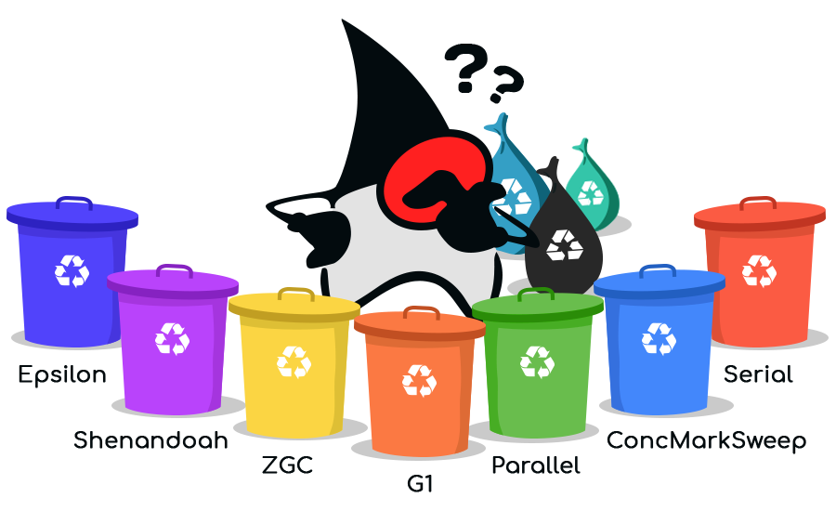
Soo… Which GC is best?
G1 GC
smaller applications
Shenandoah
large heaps
interactive websites => shortening the waiting time without requiring more CPU
ZGC
Large amounts of memory
Big data applications or Machine Learning
Notes:
Applications with large amounts of data
Heavy heaps with many newly created objects

Slide 54
Conclusion
Advantages of virtual threads and coroutines over standard threads
Release of virtual threads → small changes in code lead to significant performance improvement
Proper memory management can lead to significant increase in performance

Slide 55
Thank you for your attention!
Dora Beronić • Lara Modrić
Nina Novosel • Branko Mihaljević, PhD

Slide 56
Any questions?

