Slide 1


Designing REST API with SpringBoot
Ivan Sokol
Notes:
Hi all,
In next couple of slides I will try to explain you how in DT we are using Java to create, validate and extend REST API specifications (swaggers).
First couple of slides will be about myself and project where this is applied, followed by slides with library description.

Slide 2
@WHOAMI
Ivan Sokol
Working in Croatian Telecom (HT) for 11 years
Started as a developer (PL/SQL) in Order Management system
Integration designer and developer in Tibco ESB
Technology architect for HT digital transformation project module (BITT - STORM)
System Integration team lead
Domain architect and API Design team tech lead in DTGroup Architecture team
Member of HT R&D team
https://www.linkedin.com/in/ivan-sokol-ht/
CZ
SK
AT
HU
RO
HR
MN
MK
Notes:
13.08.2007
2
Autor / Thema der Präsentation
My HT career started in August of 2009. I started as PL/SQL developer in mobile order management system, working mostly on integration layer. That logically lead to next position, one of designer and developer (on Tibco ESB) in HT System Integration team.
When HT digital transformation project started I was chosen to standardize technology architecture, best coding practices and DevOps environment in Order Management module of transformation.
After that I became System Integration team lead, and in parallel my work on Harmonized API Layer project for DTGroup started.
This is where I am now, having roles in HT as member of R&D team, and also having role in DTGroup, as API Design team tech lead.

Slide 3
WHAT IS HAL?
HAL – Harmonized API Layer
Unified middleware layer specification for DTGroup Telecoms
Based on TMForum domain model - https://www.tmforum.org/
One specification – telco independent implementations
MojTelekom app enabler
Used in selfcare and B2B integrations
Currently has 43 API definitions
Swagger + sequence diagrams + examples
Agile methodology
CZ
SK
AT
HU
RO
HR
MN
MK
Notes:
13.08.2007
3
Autor / Thema der Präsentation
In order to explain how Java is used in team, I first need to explain project I am working on.
HAL (Harmonized API Layer) is unified middleware layer specification for 11 DTGroup Telecoms. It is based on TMForum Information Framework (SID) model. It is Swagger specification that is agnostic of implementation technology. Some telecoms implemented it in Java, others in .NET, Tibco, nodeJS, and everyone has freedom to select technology of their choice, as long as they are compliant with documentation. It is used in DTGroup as standard model for new self-care apps, B2B integration and to drive Digital Transformation.
It all started when new self care app (MojTelekom) was being designed, and unified model for backend layer was identified as an enabler for such project. Alternatively, app would need to connect to 11 different Telecoms and their own API’s, and that would be showstopper.
Currently there are 43 API definitions, covering different domains, such as Customer, Product, Product Ordering, Payment, Usage Consumption, …
HAL team is providing specification (swagger) enriched with sequence diagrams and examples in two week sprints.

Slide 4
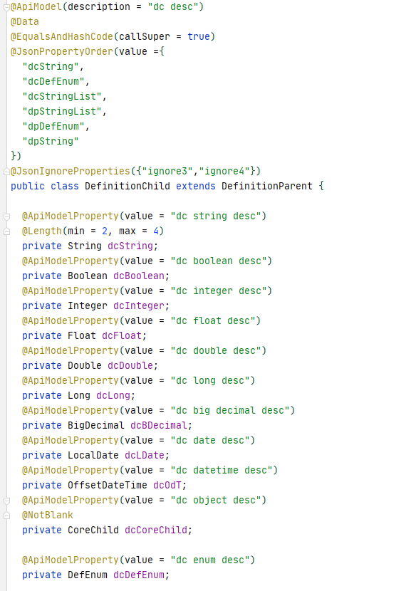
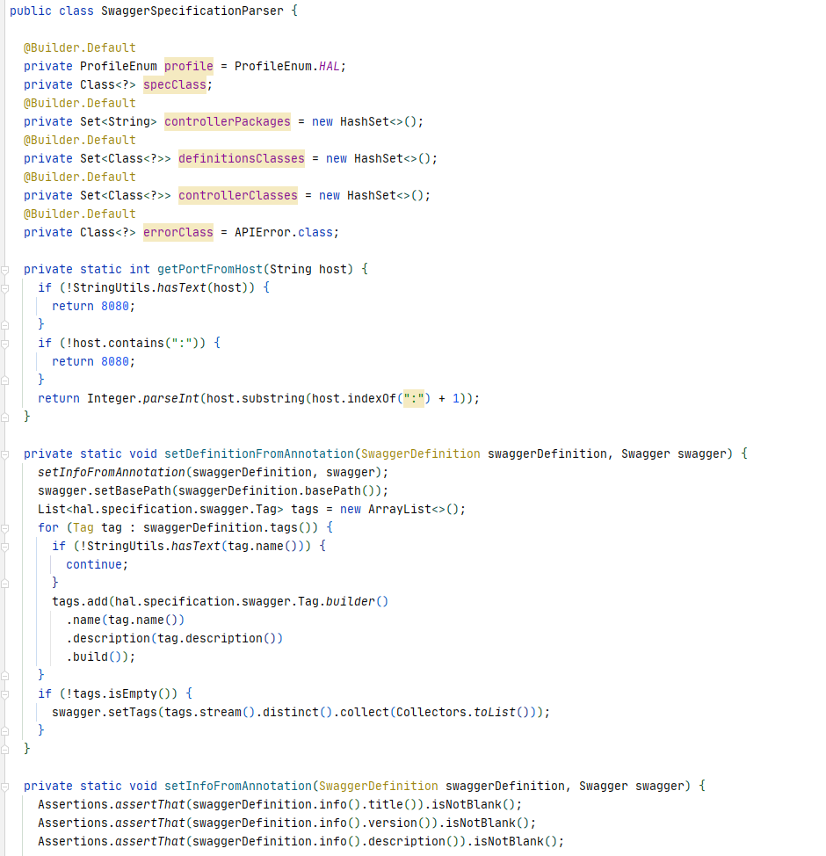
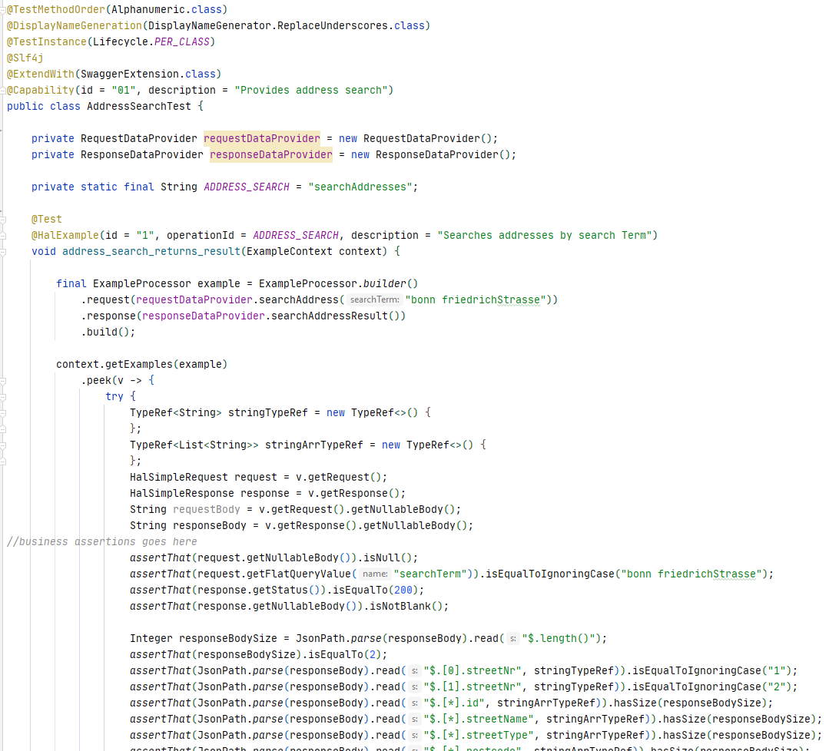
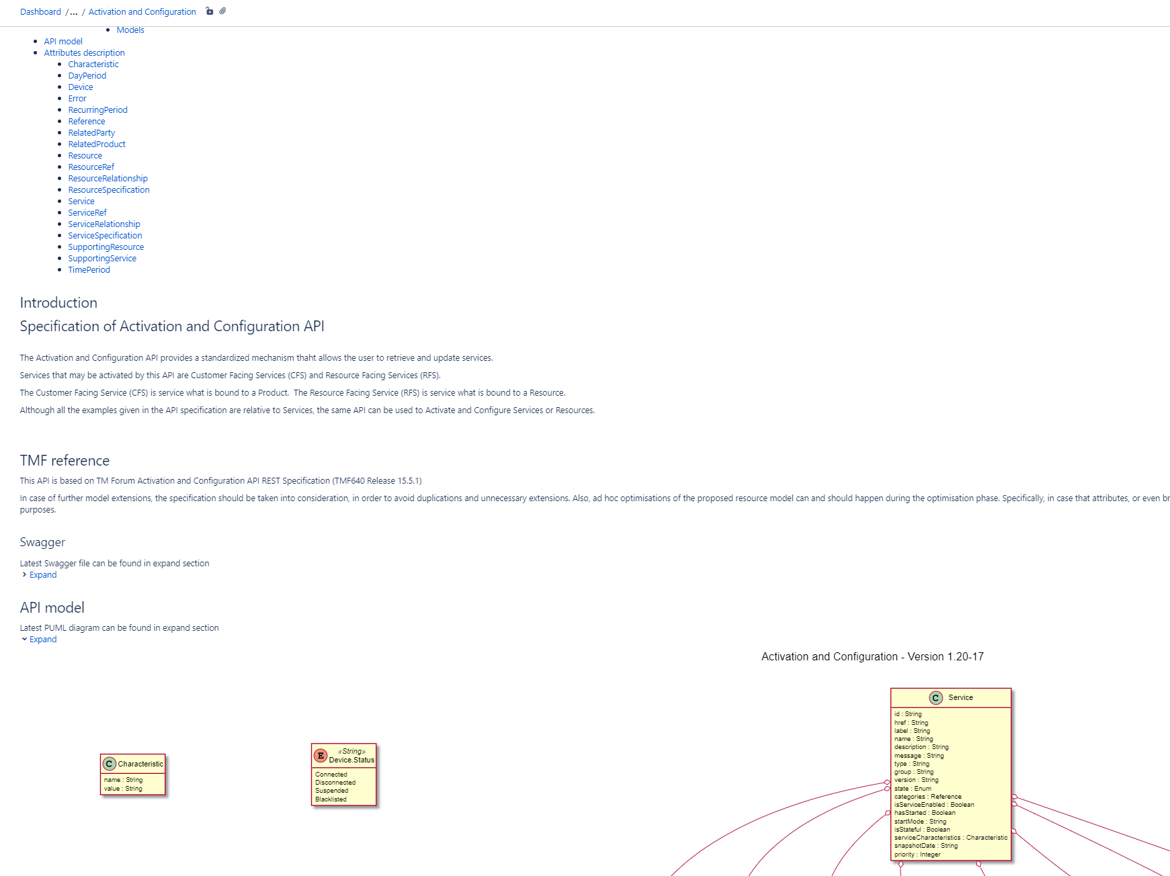
Where is java?
Design first -> generation, polymorphism, validation, consistency check
Model definition
  POJO
  Swagger, Jackson, Hibernate, custom annotations
Example creation
  Junit, JSONPath, AssertJ, Atlassian Swagger Validator
HAL Parser
  Reflection
Confluence generator
  PlantUML diagrams
CZ
SK
AT
HU
RO
HR
MN
MK
Notes:
13.08.2007
4
Autor / Thema der Präsentation
Where is Java in all this?
Actually everywhere.
We create models in Java on which certain annotations are applied by designer. We use annotations from following projects:
Swagger annotations - https://github.com/swagger-api/swagger-core/tree/v1.6.2/modules/swagger-annotations – to populate basic data needed for schema and path definition
Jackson annotations - https://github.com/FasterXML/jackson-annotations/tree/master/src/main/java/com/fasterxml/jackson/annotation – to remove, sort and rename fields
Hibernate Validation annotations - http://hibernate.org/validator/ - for easier transformation to JSON schema definition and example validations
Custom annotations – to populate JSON schema format, default responses, etc.
Junit5 is used to create tests that generate examples presented to telecoms. To validate examples we use JSONPath, AssertJ and Atlassian Swagger Request Validator libraries.
HAL parser is custom made library that uses reflection to go through all definition and path models, and as a result it generates swagger definition in YAML.
There is also supporting library that parses swagger and creates Confluence page with dynamically generated PlantUML diagrams and model definitions, so that non-technical teams can have better API insight.

Slide 5
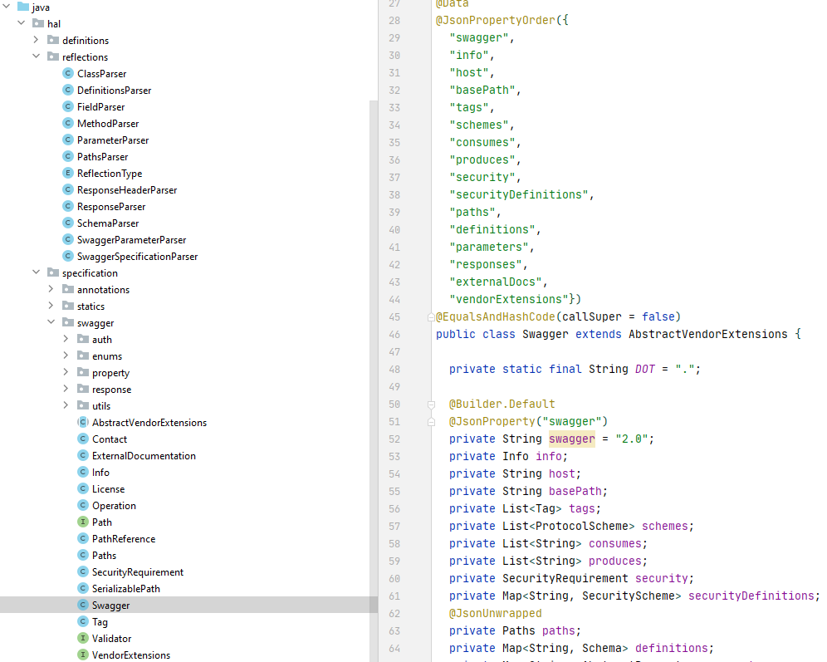
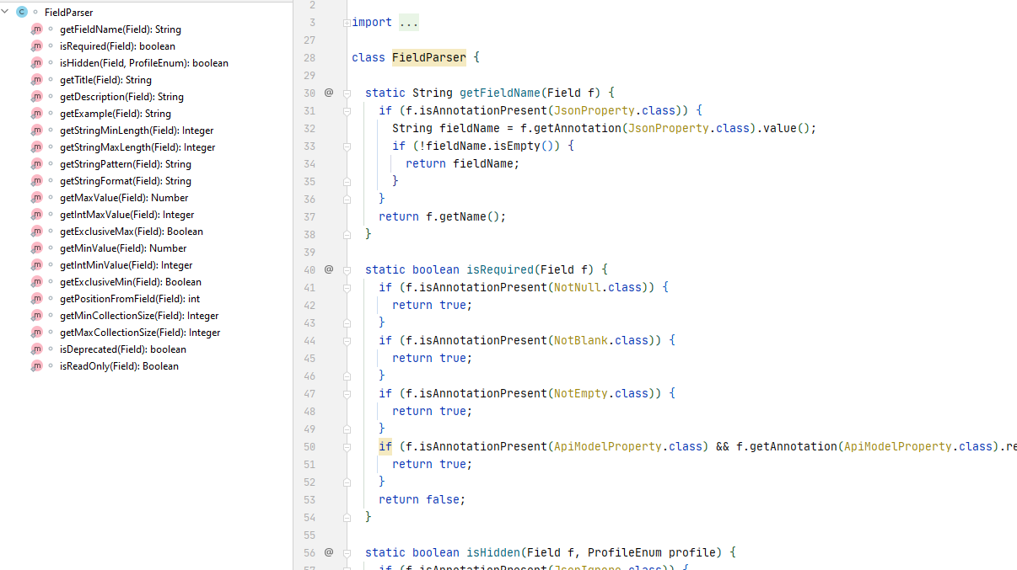
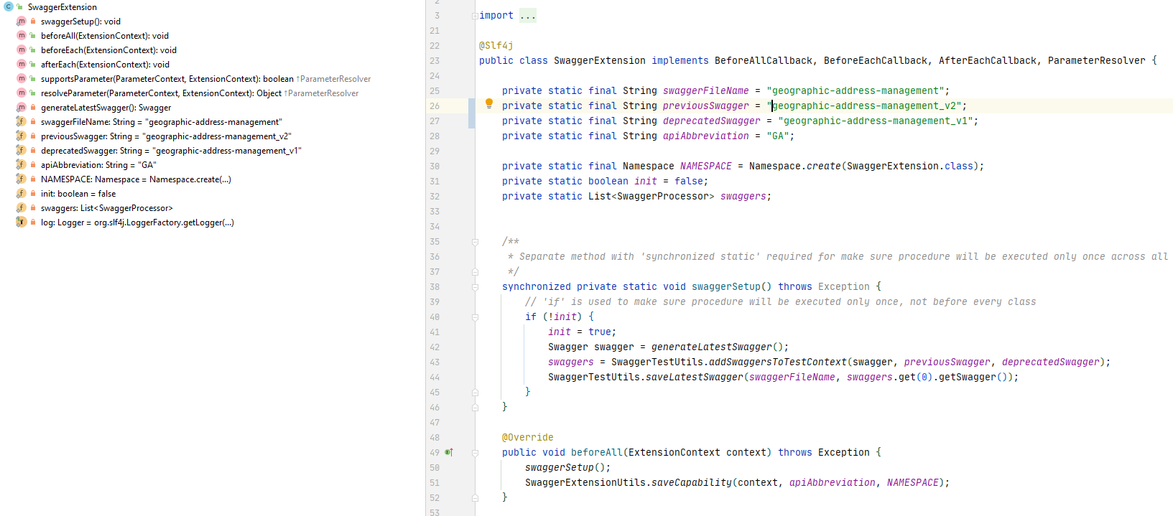
Hal parser I
Java parsing tool that uses reflection
Dedicated swagger model – based on https://swagger.io/specification/v2/
Supports Java Polymorphism – flattened JSON schema
  Field renaming/removing/sorting
Supports specification profiles
  One model, multiple swaggers (admin, public, …)
Specification extensible
  Single model – different outputs (Swagger, OpenAPI, Async API)
Example validation
  Previous swagger validation
CZ
SK
AT
HU
RO
HR
MN
MK
Notes:
13.08.2007
5
Autor / Thema der Präsentation
HAL Parser is tool created in Java 11. It uses reflection utilities to scan over annotated Java classes and as a result it produces Swagger specification file.
To do this, it has it’s own Swagger classes enriched with Jackson annotations. Why is it not using swagger models that can be found at https://github.com/swagger-api/swagger-core/tree/v1.6.2/modules/swagger-models/src/main/java/io/swagger/models? Library design started with idea to use those models as core components, but lot of the classes had supporting functions that were not easy to implement and some of the behaviors we wanted to change, but it was not possible.
This is why we took pure specification found at https://github.com/OAI/OpenAPI-Specification/blob/master/schemas/v2.0/schema.json and designed our own Java classes that are more simple, extensible and easier to read
Going by DRY principle, we also fully used Java polymorphism, as JSON Schema v4 (upon which Swagger 2.0 is based) doesn’t support it fully (only allOf). Parser is flattening all fields from scanned classes to one schema definition. But it is not only supporting extensions by adding new fields in flattened schema. It also supports sorting of fields (Jackson @JsonPropertyOrder annotation), removing fields (Jackson @JsonIgnoreProperties) and renaming (Jackson @JsonProperty).
Because of stakeholder requirement to produce two different swaggers for the same API (for example publicly accessible swagger and admin interface swagger), we also introduced concept of Profiles. Basically, every field and method can be marked with Profile annotation. When parsing, tool is always adding non marked fields in schema, but if some field or method is marked with different profile, it is not put in schema unless this profile ID is set as parser input. Like this we don’t need to duplicate classes and potentially create more errors.
Specification is also extensible. Currently there is design going on to introduce OpenAPI specification model, extend some of the annotations and then using data collected in reflection to generate both OpenAPI and Swagger specification. Of course, if designer uses some of annotations not found in Swagger spec, he will be warned that Swagger spec cannot be produced. This is based on requirements of some of the stakeholders (but not all of them) to migrate to OpenAPI. And in next step we also want to support generation of AsyncAPI definitions.
One of the core library capabilities is validating examples produced by designer. On the beginning of project it was concluded that producing only Swagger specification was not enough for developers to implement it, as in some cases there are two or more ways how to interpret models and methods. This is why it was agreed on project level that swagger, sequence diagram and examples will contain full solution, as it is then more clear to everyone what needs to be done and how.
For sequence diagrams we didn’t have problems, PlantUML was used as a developer friendly tool that is generating diagrams from code. And this code is then put in git and versioned through sprints.
With examples we had lot of issues in the beginning, as every designer used it’s own tool to write specifications, and examples were written by hand (JSON files). So whenever specification changed (and there were a lot of changes in the beginning, when API’s were not mature enough), designer needed to adjust example by hand. This was prone to many inconsistencies.
Then we introduced SpringBoot + Springfox as a way to define models and run tests over examples to verify them. Designer would define example (that contains both request and response) in project folder, it would create unit test with assertions for it, and run all tests. Test supporting code would read example, use model found in src/main, deserialize+serialize it using Jackson with strict rules and call HTTP Spring endpoint with request. There was automatically generated Service layer that could pick response from disk and return it back as response. Test would then use response as assertion library input. If example was not consistent with model then Jackson would throw errors, if it was not consistent with method definitions Spring would throw errors and if it was not consistent with business rules, assertJ would throw errors.
This process was big evolution over manually written examples, and it had many iterations until we found most optimized approach, but it still had some issues. Most notable one was slow execution of unit tests (43 gradle projects and more than 900 examples). Also, some supporting code needed for Service layer to work correctly was automatically generated in build process.
With new requirement from stakeholders to run example through up to 3 latest major versions of specification (to find out what is most earlier major specification version that can support such example), this kind of process was showstopper to provide such solution.
This is where new parser enabled such functionality. It changed validation process to be based on swagger and not spring controller + java classes. Jackson is still used to strictly validate examples written in project folder, but rest of the process is different.
Now for each API developer can provide 2 previous major swagger specifications from disk. Latest specification is generated by parser. In test preparation (using Junit5 supporting classes), parser is loading all swagger specifications, validates them and creates up to 3 instances of Atlassian swagger request validator objects.
In unit test developer loads example in parser and runs function with assertions in it. Parser is running examples through all swaggers, removing fields not found in specification and then validating what passed through filter. If there is an error on latest swagger then exception is thrown, and if there is an error in previous swagger validations, that is raised as warning and example is marked to be able to run on latest version that passed validation.
This also had side effect of not needing Spring context any longer, so tests were must faster.

Slide 6
HAL PARSER II
vs other tools
Springfox
  Complex model
  Code first
  Not extensible to many outputs
  Spring dependencies needed
Online tools
  Example validation support minimalistic
  Model reusability
  No multiple outputs
  Vendor lock
Next steps
OpenAPI output (work in progress)
AsyncAPI output (next milestone)
  Support for complex validations:
    Using JSONPath
    Saved in swagger as vendor extensions
Notes:
13.08.2007
6
Autor / Thema der Präsentation
When comparing parser with other tools, there are obvious downsides (HAL parser library needed to be developed from scratch) and benefits.
Main point is that HAL parser is result of needs in a specific project where delivery doesn’t just include swagger + couple of examples, but swagger + many examples (in some cases more than 100 per API). In order to have documentation correct, technical validation of all examples per swagger definition was mandatory requirement that was later extended with verification of examples through previous swagger versions.
Also, now we are facing new scenarios, where some telecoms are requesting specification to be delivered in OpenAPI format. And some projects are requesting examples to be defined for async communication over Kafka. There is also requirement to have complex validations (if field A value equals true, then fields C and D are mandatory) that cannot be defined in JSON schema (at least not for now, perhaps this will change in OpenAPI 3.1)
All of this would not be possible if we choose to do it in some online tool. We used Springfox in one of the previous iterations, but it was introducing additional complexity, limiting us in some design approaches and slowing down unit tests, as it needed Spring context to be loaded. It is definitely good tool if you are on Spring and doing code first approach, but that was not case for us.
To conclude, if you are designing an API, never do it by hand, there are free (GUI) tools available that can speed up the process. But when you have complex requirements from stakeholders, Java is more than capable to deliver complete solutions

Slide 7


That’s all folks!
Contact
ivan.sokol@t.ht.hr
CZ
SK
AT
HU
RO
HR
MN
MK
Notes:
13.08.2007
7
Autor / Thema der Präsentation
If you have any questions you can contact me over LinkedIn profile https://www.linkedin.com/in/ivan-sokol-ht/ or my email
Thank you.

