Slide 1
SmartDB
The presentation discusses the Smart-DB + ThickDB concepts, a database-centered architecture: Good and Bad.
From the monitoring-data of several systems (using Statspack, AWR, OEM and Lab128) we show symptoms, explain diagnoses and suggest fixes. The goal is to explain where SmartDB works (mostly) and (sometimes) doesnt work.
Background: From various systems I've helped build and/or troubleshoot, I think I can deduce some advantages and pitfalls to mix in the discussion about SmartDB and IT architecture in general.
Note: The Logo on next slide….
This “knowledge” is easily transferrable !

Slide 2







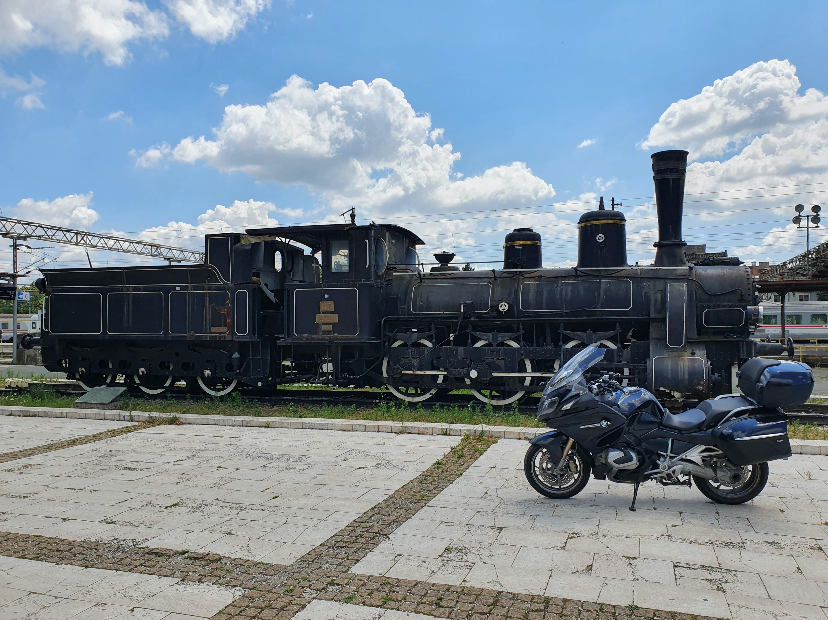
Piet de Visser
PDVBV
Smart DB – Thick DB…
Bring Code to Data
A DB-centered architecture.
#BringCodeToData
PDVBV – The Simple (oracle) DBA
Favorite Quotes: “The Limitation shows the master” (Goethe), “Simplicity is not a luxury, it is a necessity. Unfortunately, “Complex’ solutions sell better. (EW Dijkstra).

Slide 3














Logo Cloud
Portbase
Shell
Philips
ING bank
Nokia
(dutch gov)
Insinger, BNP
Etihad
NHS
BT
Claritas, Nielsen
Unilever
Exxon
GE
Don’t waste time on Self-Inflation… but Hey, this was such a cool Idea (from a marketing guy)…
Logos of my major customers over time. If you want your logo here: Hire me.

Slide 4
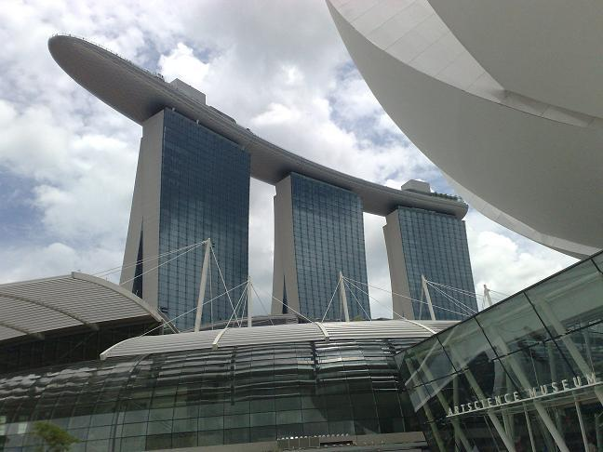
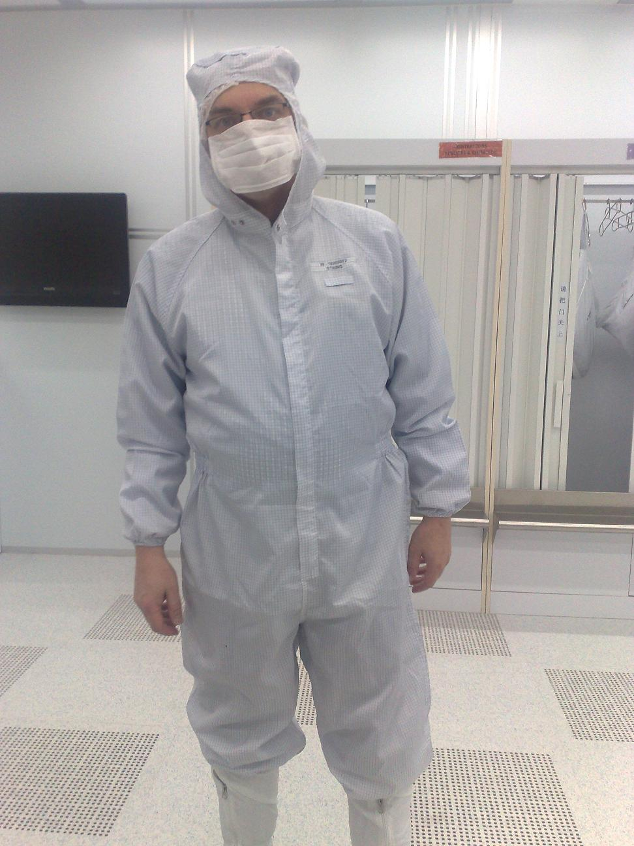
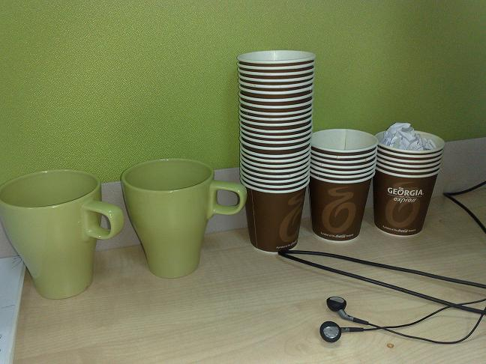
What does it look like..
Couldn’t resist… after this changing room, not allowed to take pictures anymore..
For travel pictures from Asia: later…

Slide 5
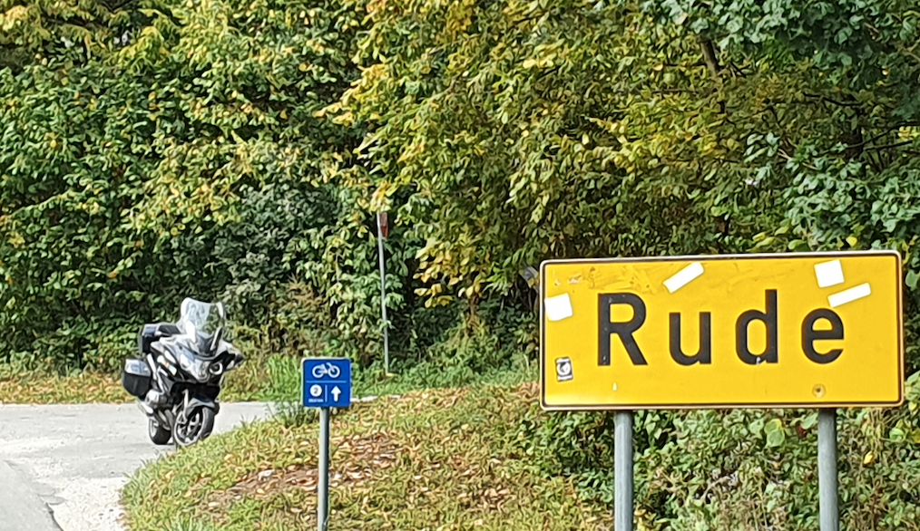
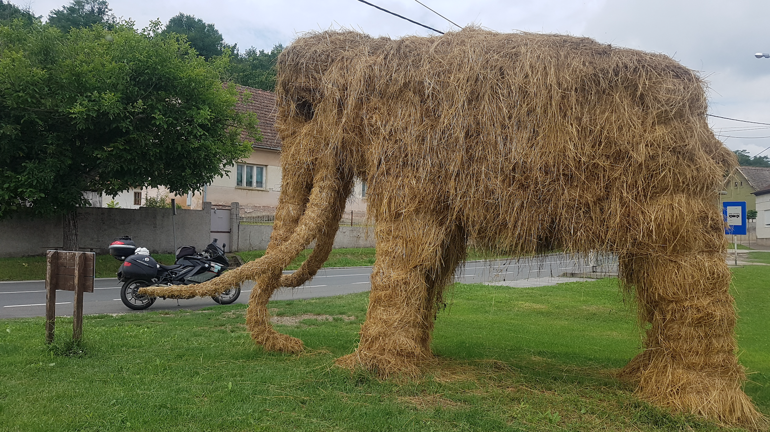
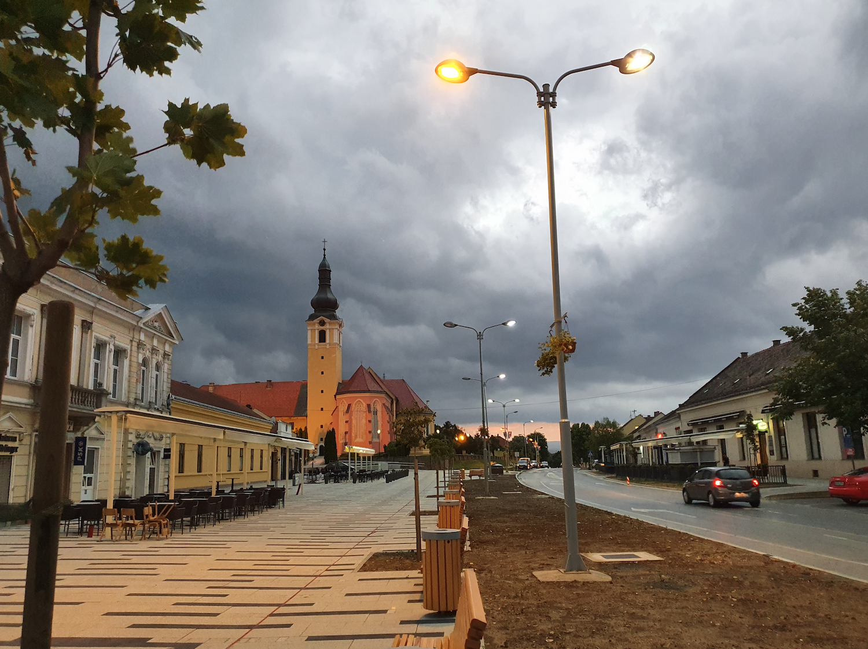
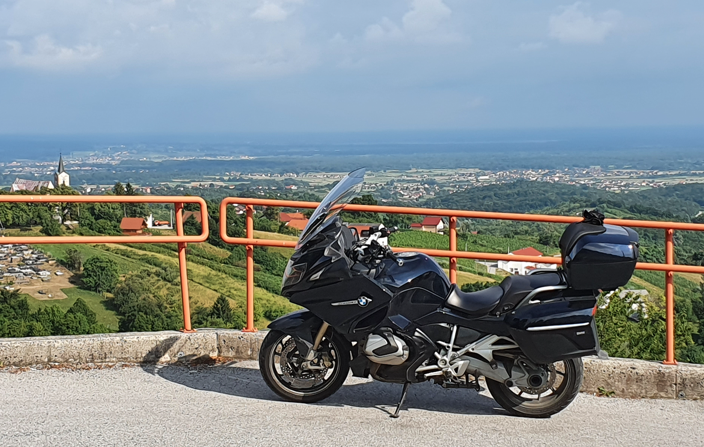
What does it look like..
Couldn’t resist… after this changing room, not allowed to take pictures anymore..
For travel pictures ..rude, ilok, nasice and Jastrebarsko

Slide 6
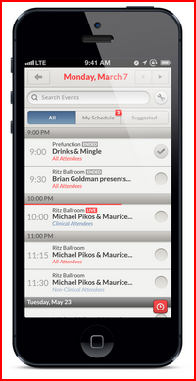
Agenda (approx 45 min)
History (why this…)
Bring Code to Data (main msg)
SmartDB (PinkDB…) (old knowledge?)
A few Cases.. (Quiz Zzz !!)
Some Quotes (Smart!)
10 min Discussion (Do Challenge!)
Agenda. Why, what, how, Illustrations, comparisons.
30+ slides, 1min/slide.

Slide 7


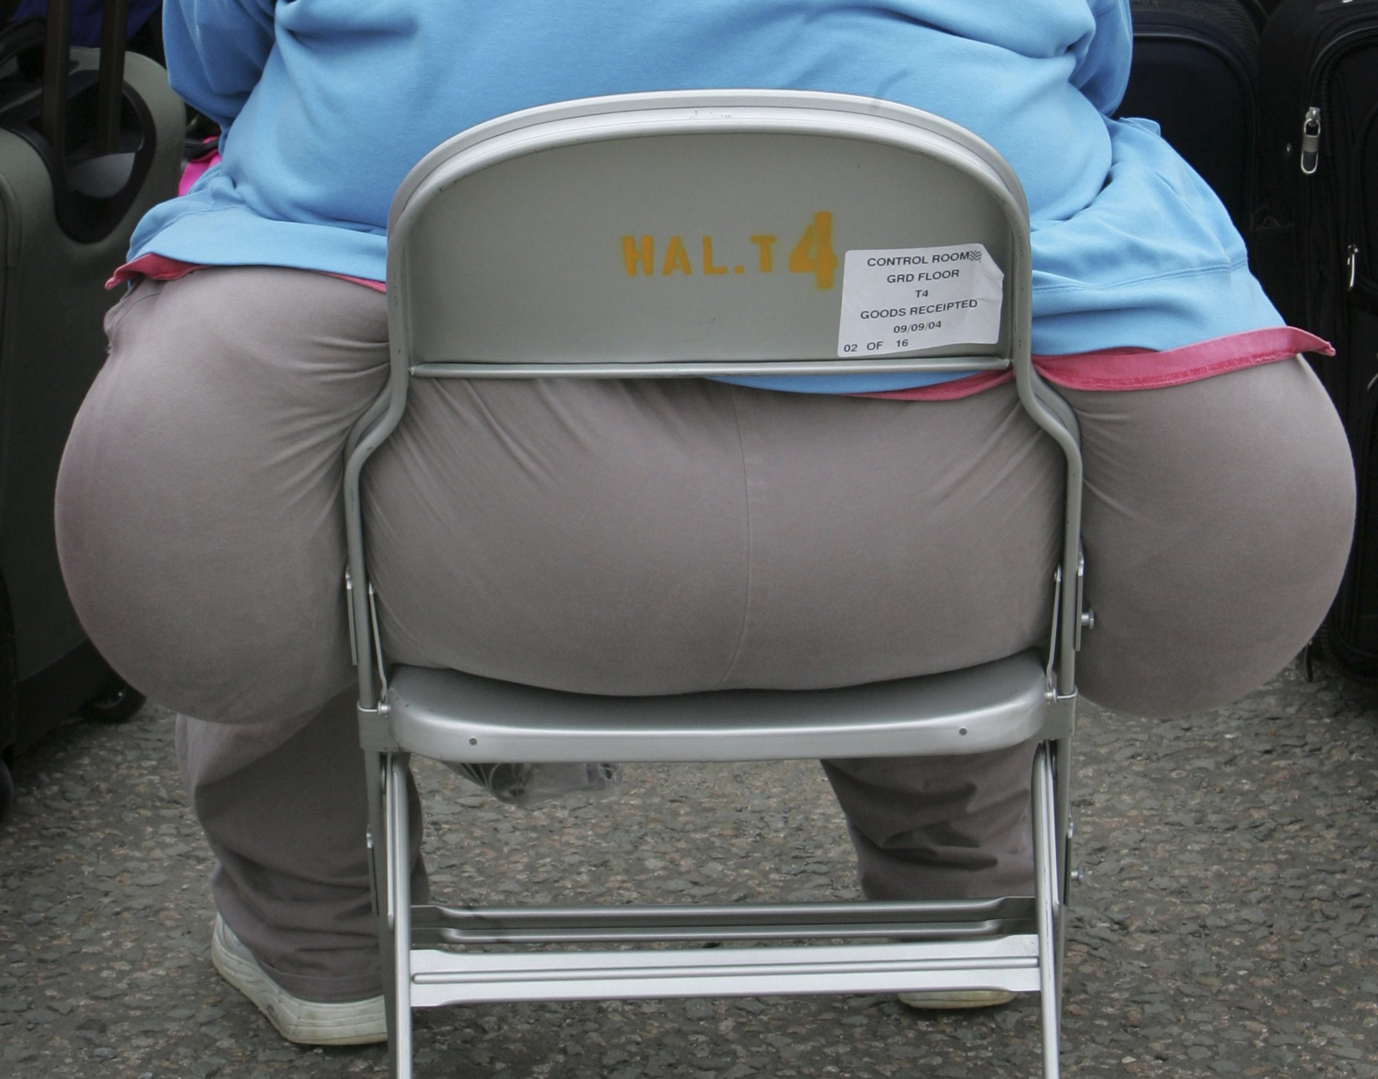
Be Smart: Use your Database…
Your system needs a Database…?
USE. That. Database!
Work with Data? => in the DB.
Data Gravity, applies to code too
#BringCodeToData
SmartDB, ThickDB – All Good.
Let me try explain why …
Thick DB?
Image: fat..?
Athlete!
Thick DB… nope: Smart DB! ( c.f. Toon, Bryn, Peter Salvis…) (Datam model design)
Your Database is quite capable of some Heavy Lifting and some Agile Moves.. (no WITty jokes pls)

Slide 8
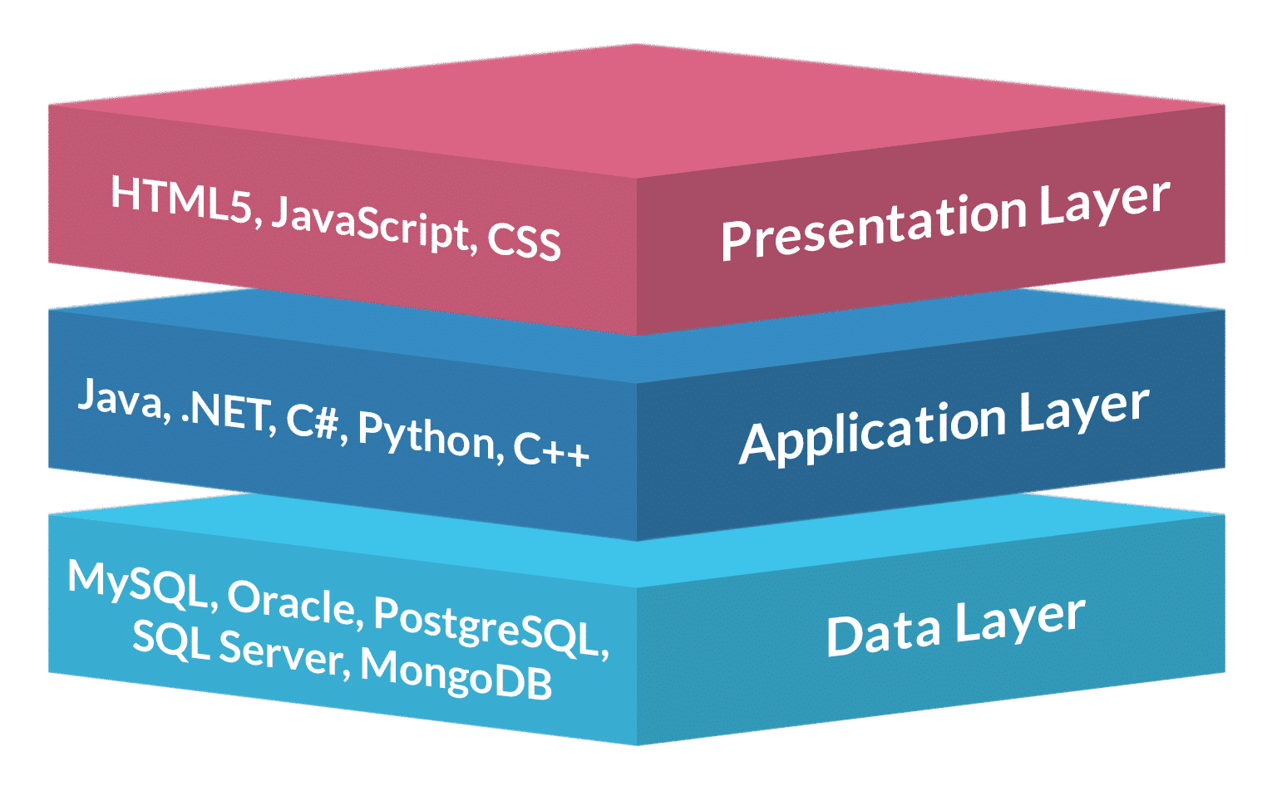
Three Main Problems I’ve Seen…
“Find the problem” – in Layered system…
  Is it the DB ?
  Is it some Java component ?
  Is it the browser / front-end / app / Citrix ?
  Is it the network / latency / bandwidth .. ?
Performance: “Chatty Protocols”
  Slurping data from DB.
  Pushing data to DB.
Fix old code (tool-of-the-day)
  COBOL from the 60s? “Dot. “
  Forms 3.0 from 1996 ? (screen-triggers)
  Dotnet-stuff, VB from 2002 ?
Image:
DB+App_+browser
In my “fixer” job, I come across these 3 problems… 1-chaty, 2-hunt-probblm, 3-old-code

Slide 9


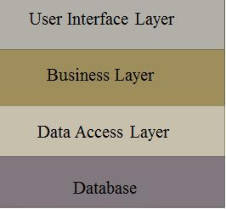
Additional Arguments..
Security: APIs and Whitelisting.
  #SmartDB Limits the exposed surface
  Scrutinize, sanitize incoming calls and arguments
Layers of an application:
  Persistence (tables, ACID, this _is_ your DB).
  Business logic (belongs close to data, in DB)
  Ux, the UFI (not obvious to put in a DB)
Uptime + Live-maintenance.
  Solved by EBR etc. (go see Bryn)
  “EBR” Works in all Databases, but is more “work”
  Multi-version API’s, views, synonyms..
Note: I am in favour of exposing the Data-model to all Devs, and even to users.
Note: I don’t care bow many layers in the DB, but 1-in the DB and 2-not too complex plse.

Slide 10

Four “cases”, good and bad
Recent discussion with a Dot-netter (Solved!)
1800 Msg/sec.. (Fixed!)
Adhoc-SQL-generated (JFDI)
A CPU-heavy database… (KIWI…)
(Attn: there will be an Exam-question…)
www.userfriendly.org

Slide 11


Dot-Net: an “Array of Objects” (1/4)
Dev (a dot-netter, possibly in the room):
  Had to process sets in the app (dot-net)
  Had to fetch the data into arrays (from MS-SQL)
  Had to loop through the Arrays.
  Had to Write results (ins + upd) back to DB..
Me: how about T-SQL ?
  Call Procedures, use “sets” (= SQL)
  Avoid dynamic sql… avoid injection.
Dev:
  After a PoC, for “performance” … T-SQL .. Yes!
  Now a DBA / programmer.. ( …is that a bad thing?)
This guys tricked me into explaining the Set-Based part of DB-processing with some beer-cartons…
Demo this with Beer-cartons?..

Slide 12
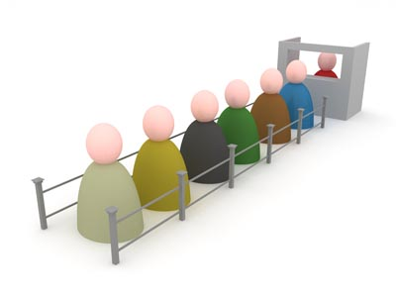
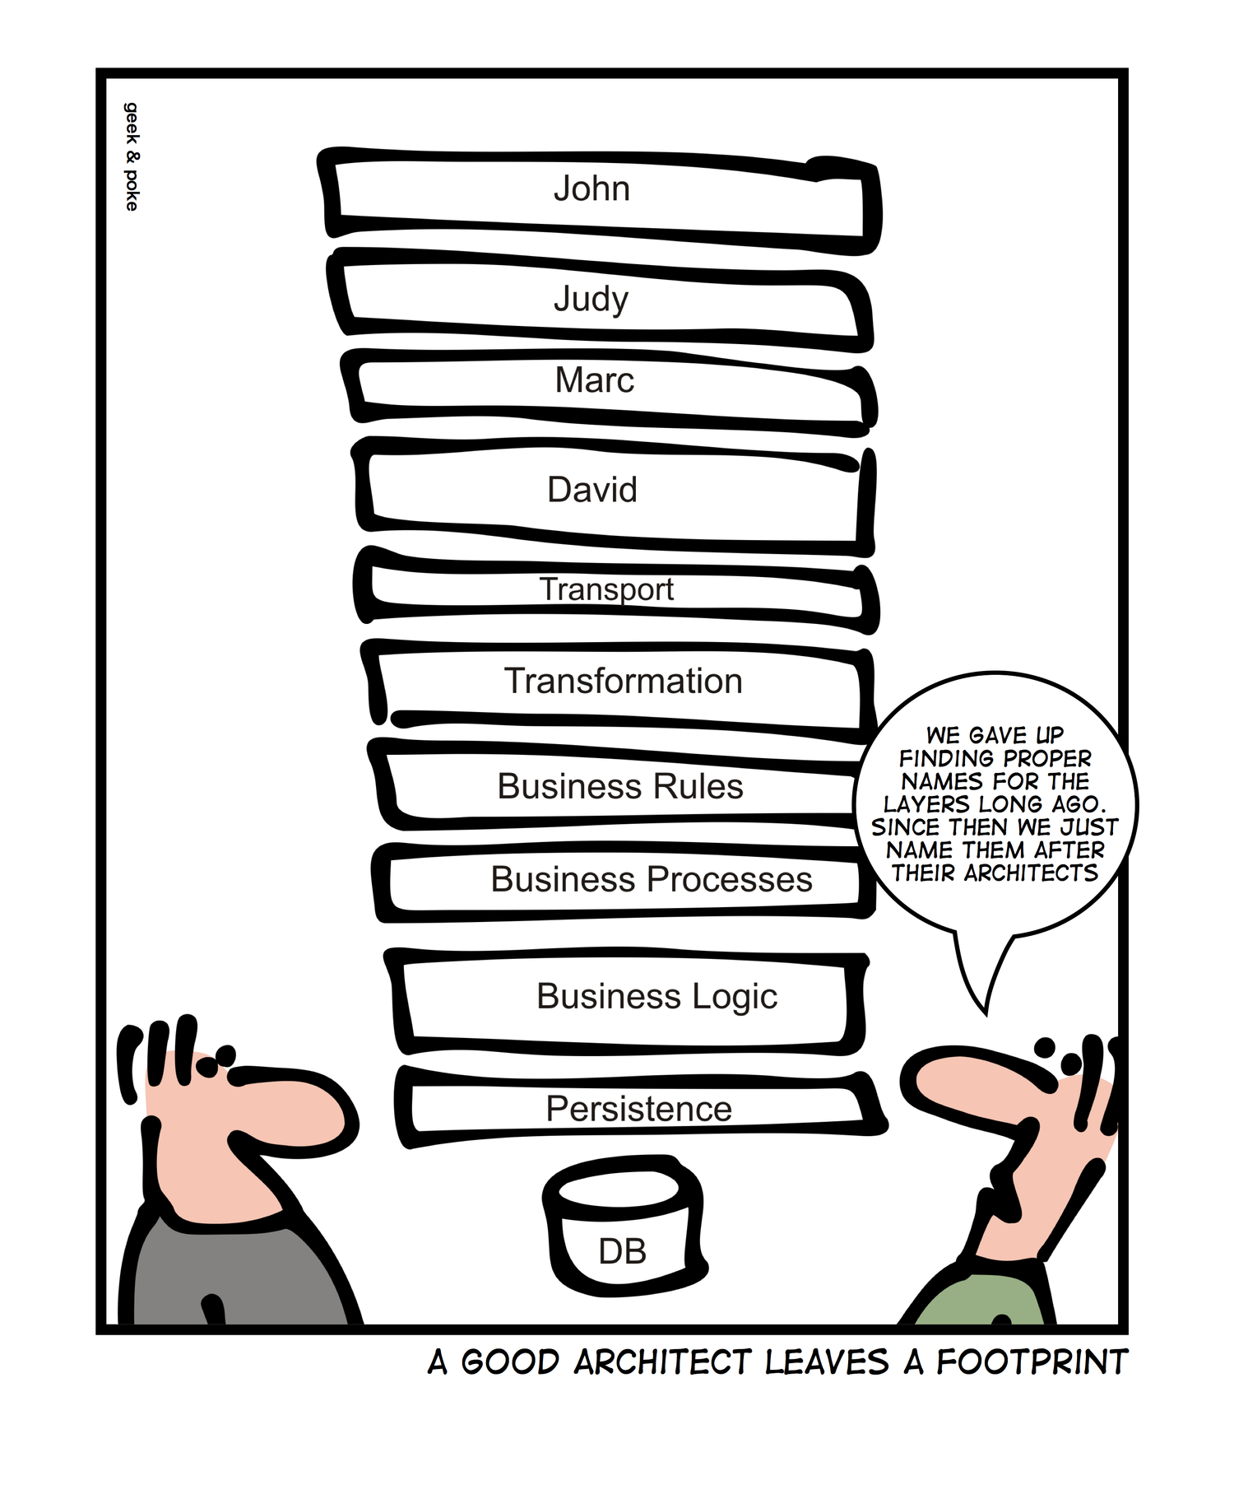
We need 1800 tx/sec… (2/4)
Cstmr: we need 18 Hundred Tx/sec
  Relatively simple “9 messages”
  Sort of a PAYG : Qry / Upd / Log )
Me: That is +/- do-able.
Cstmr: we only got to 17…
  I’m thinking: Fixable, but nope.
AWR (monitor tool) showed:
  300 calls/msg…(lots of double work too)
  7 Layers of Java in the app-stack…?
Solution : PL/SQL, Program inside the DB!
1800/sec on 32cpu machine.. 10ms/tx, Feasible., roughly 60% of machine
Layers.. Named after the architects…

Slide 13
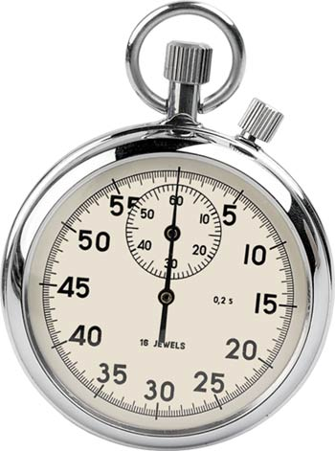
COTS: Queries take too long… (3/4)
Cstmr: Our database has slowed down…
  Please JFDS
Me: How about an AWR (monitor..) ?
Aiii… Nested SQL went up to 9 levels deep.
  Generic datamodel, Software-generated Queries..
Instinctive reaction : JFDnt (Dont)
Diplomatic: Too much work for OLTP
Next Day..
  “We un-checked some of the options..”
Fixable, because “seen in DB”
Some problems can not be solved by the DB..
But you _can_ find them by looking at the DB.

Slide 14
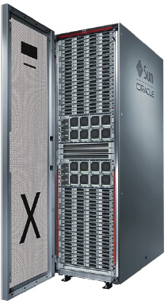
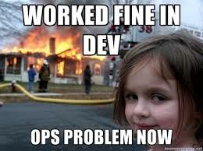
System from Hell (4/4)
Data++…Slow screens, Slow Reports, even Slow MVs
KIWI… Moved to Exadata: _Only_ +/- 3x Faster…
Users, Operations: Still Suffer…
Management :
Root Cause Analysis ?
# cat /etc/RCA
Start by observing …
Image:
beard..
System had moved to Exadata, but was “only” 3x faster, and in some cases not at all…
Note: I am part of a “IT Repsonse Team, we go listen and help… (5 MS/sharepoint ppl, 1 Oracle DBA…)

Slide 15
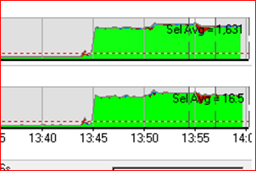
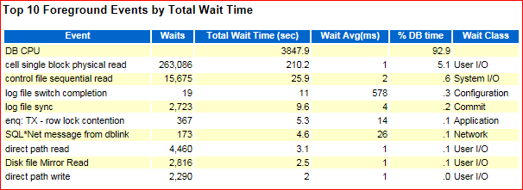
Investigate…
Start by observing..
Use OEM (…Lab128, sar, Ash-V)
Isolate + run Test-cases
Extract AWR reports
Image:
beard..
System was only using CPU – green graph from lab128 is typical “test”,
AWR was a 30min report – 92% of activity is CPU… “average” only 2 sessions active. During test … 16 sess.

Slide 16

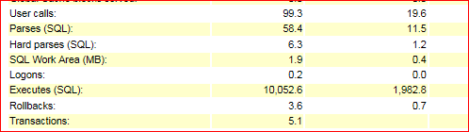
Findings..…
AWR and Lab128 show:
CPU only (hence 3x gain from Exa)
Very high nr of “Executes”
( and Several SQLs at same-frequency )
System was only using CPU,… high nr of “executes (10.000, open AWR.…)
(and relatively low nr of user-calls, no chattyness) => this indicates lots of PL/SQL activity (we have a start)

Slide 17
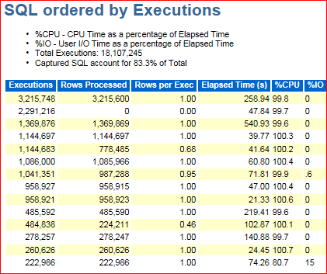
Findings..… (zoom in)
Most executes seem to query same “Objects”
STMNT_TEXT
------------------------------
SELECT CLASS_NAME FROM OBJECTS
SELECT CODE FROM OBJECTS WHERE
SELECT OBJECT_ID FROM OBJECTS
SELECT START_DATE FROM OBJECTS
SELECT 1 FROM OBJECTS O WHERE
SELECT CLASS_NAME FROM OBJECTS
Millions of Excutes, all fetching 1 row or less, mostly from a table called “objects” – a View, actualy…

Slide 18

Views -> Functions -> View -> Tbls ./.
Top to bottom first…
“Rich” application, uses Views to define “things”
  “generated code”, including INSTEAD-OF triggers
The Views use Functions (mostly in Pckgs)…
  both in Select and in Where (and in joins)
  Get_name_of_mything ( thing_id) returns varchar2…
Functions query “Objects”
  Objects is a view… (of 136 tables)
Let me try explain…
Show that the object-view created with best of intentions… Generic model, very Flexible, very “Rich”
in functionality. This application is “deployed” differently per client, per instance.

Slide 19







Many layers between User and Data.
Reports use the views
Screens use the views
Mviews to help…
View-layer: “functions” to show columns,
With “instead of“ triggers on INS / UPD / DEL
4200 packages (18 depend on “objects”)
Pckgs provide functions…
6000 views, some direct to tables
Objects-view,
We found… 136 small Tables
2000 other Tables
(only a few in use)
Show that the object-view created with best of intentions… Generic model, very Flexible, very “Rich”
in functionality. This application is “deployed” differently per client, per instance.

Slide 20
Root Cause (we think): Views + pkgs
Create View RichView as (
Select
  pkg.get_attrib_f1 (id) as atrrib1
  Pkg.get_attrib_f2 (id) as attrib2
  .. Etc..
From SomeTable [, MoreTables ]
[ whereclause, some with functions]
);
Note: Generic, and potentially Flexible system…
(Add instead-of triggers.. Make it more Flexible still..)
Views defiend using packaged-functions… flexible, generic, potentially very “rich” in functionality.
And it worked fine in testing…

Slide 21

Now join + filter using those views… ./.
Select v1.attrib1, v2.attrrib2, etc …..
From Richview1 v1
, Richview2 v2
Where
v1.attrib1 = v2.attrib1
And v1.attrib2 > :x
And v2.attrib2 = :y
And .. More…
Columns … Cause function calls
Joins… Cause Function-calls
Where-filters… Cause Function calls.
Now start using those views… and they start calling functions..
Often the same function with the same arguments.. (room for investigation + optimization, later)

Slide 22
Quiz: Smart DB or not ?
Is this a SmartDB application Y/N ?
  Why (not) ?
Having all “code” in the DB Helped…
  We could find + Fix some of it.
  Fix1: out-comment stuff.. (not very smart, but it helped)
  Fix2: bypass some of the code (in Reports).
  Fix3: Function-result-Cache..
Smart-DB Saved the day…
  System would not have survived this far.
  It would probably not be fixable…
Hint: Most / All processing happens “in the database” .. (Thick DB!!) - no dynatrace or new-relic…
But this App is trying to be Very, Very Clever… and is a Huge CPU-gobbler

Slide 23
Fix1: /* eliminate code */ …
/* -- eliminate code -- */
Once we got a “knowledgable” developer on the reports.. They started to Fly!
Trick was to /* eliminate */ unused columns from queries.. That reduced the calls to fuctions !

Slide 24
Fix2: to Bypass layers…
Once we got a “knowledgable” developer on the reports.. They started to Fly!

Slide 25
Four “cases”, good and bad
Discussion with a Dot-netter (Solved!)
1800 Msg/sec.. (Fixed!)
Adhoc-SQL-generated – The DB told us “Dont”…
A CPU-heavy (KIWI) : “fixed” in the DB.
Conclusion: SmartDB, ThickDB… It Works!
Serious IT system? Google for Pink-DB!
www.userfriendly.org Google for philip Salvisberg, PinkDB.. The most user-friendly description of the smart-db concept

Slide 26
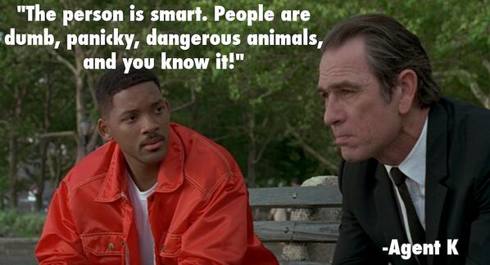
Favorite Quotes…
You probably know the movie...
A DB is Smart.. Applications are dump panicky animals, and you know it..

Slide 27


Smart DB… Worth it ?
You probably know the movie...

Slide 28
Summary Smart DB
Smart Code is Closer to the Data
Code lives longer in a DB
Code is Easier to find+Fix in a DB
Code Performs Better in a DB.
System is easier to Secure.
Overall more “efficient”, Less need for KIWI
Uptime + version-releases:
  is a “Solvable problem” - EBR or otherwise.
Scale-Out: Not a real issue (anymore)
DB-cpu + storage are Cheap+Fast
Image:
Fat / athlete
www.userfriendly.org

Slide 29


Analogy…
#SmartDB
#ConvergeDB
#BringCode2Data
Most of us could not carry the Dolmen.. That is why we bring the hammer + chisel to the stone..
(and the marketing hashtags…)

Slide 30
Smart DB – Pink DB
#SmartDB
Don’t Drag Data Around…
Data-Gravity
#BringCodeToData
www.userfriendly.org = and Add Asterix ?

Slide 31

Now you know about Smart-DB…
You probably know the movie...

Slide 32
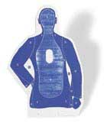

Quick Q & A (3 min ;-) 3 .. 2 .. 1 .. Zero
Questions / Pitanja ?
Reactions / rreakcije ?
Experiences from the audience ?
Question and Answer time. Discussion welcome (what about that Razor?)
Teach me something: Tell me where you do NOT AGREE.

Slide 33
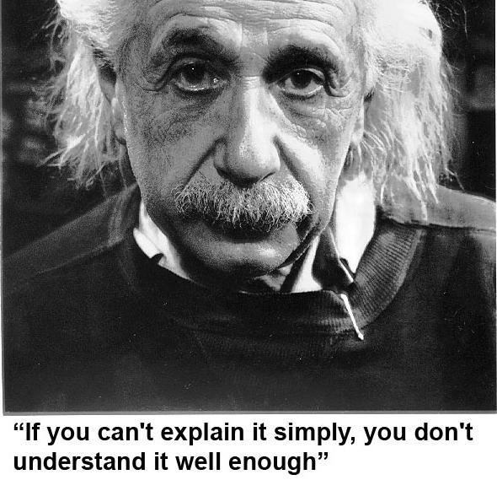
He got it …
As Simple as Possible, but not too simple
Simplicity is a Requirement - but Comlexity just sells better (EWD).

